Slide 1
TIES4560 Demo 2
Suvi Kaasalainen,
Leevi Liimatainen,
Petra Puumala,
Teemu Vähä-Impola

Slide 2
Task 2.1 - Web Service with Web API
Background and Business logic are continued from Task 1: Room Reservation Service
We implemented Capacity service as our own SOAP service
Service provides functionalities mainly to service owner
Functionalities: get all rooms, add, update and delete room
We used Postman as API client

Slide 3
Use cases
http://localhost:5000/rooms
http://localhost:5000/room (GET to get a room/POST to add a room)
http://localhost:5000/update
http://localhost:5000/delete
Parameters 'id', 'name' and 'cap'(= room capacity)

Slide 4
Task 2.2 – A Simple REST Client Exercise
Dropbox web client
Connect to your app in Dropbox via user authentication.
Get information about the user’s account
Upload an image to the folder of your Dropbox app
Extra actions:
/get_space_usage
/count
/create_folder

Slide 5
Extra actions: /get_space_usage
Get the space usage information for the current user's account.
https://api.dropboxapi.com/2/users/get_space_usage
POST
Parse-function removes unwanted characters from string and splits the result in half to an array. In first index of the array is used data and the second index includes information about allocated data.

Slide 6

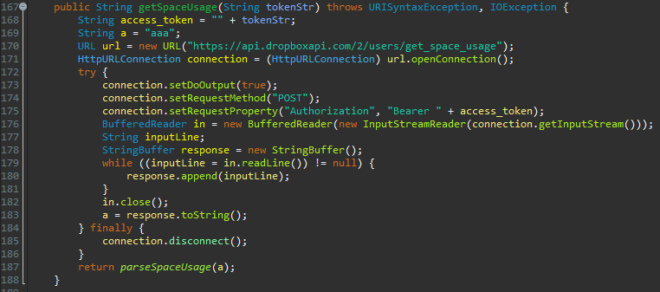
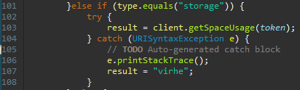
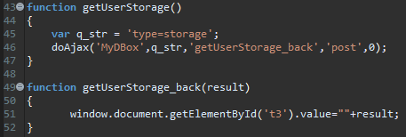
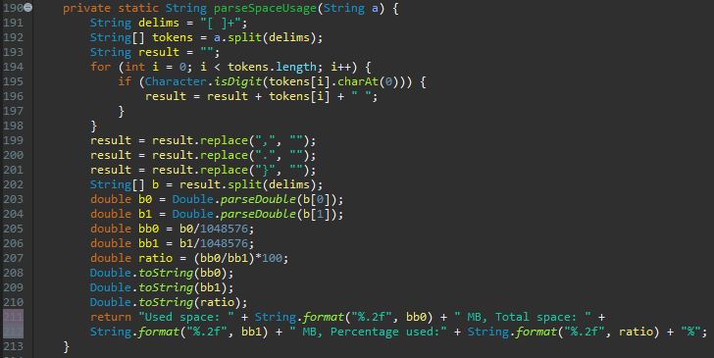


Slide 7
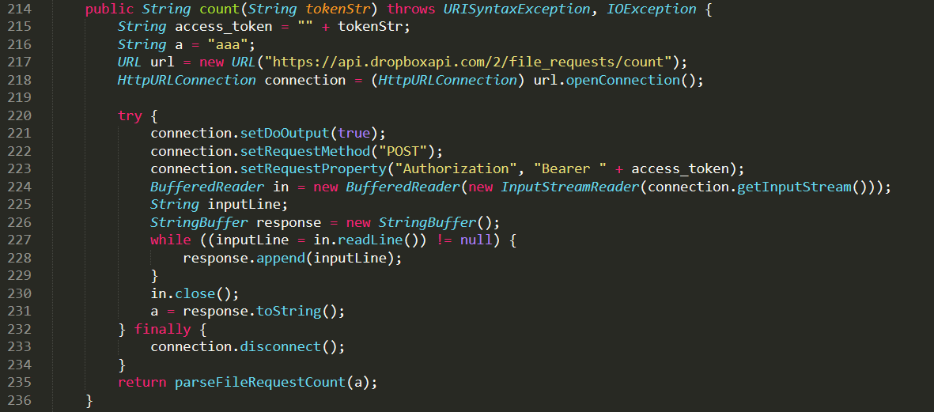
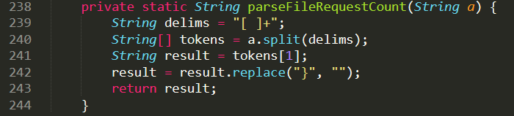
Extra actions: /count
https://api.dropboxapi.com/2/ file_requests/count
Returns the total number of file requests owned by this user. Includes both open and closed file requests.
Has also a parse-function to get only the number out of the string returned.

Slide 8
Extra actions: /create_folder
https://api.dropboxapi.com/2/files/create_folder_v2
Create a folder at a given path.
POST
In this case parsing not needed

Slide 9
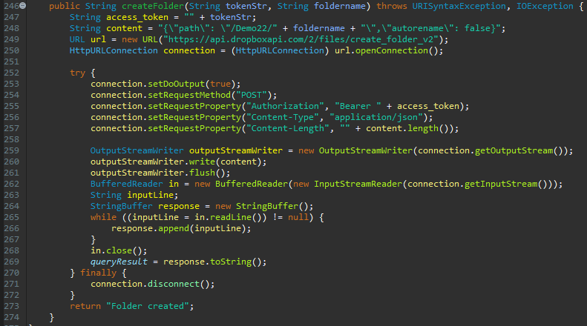
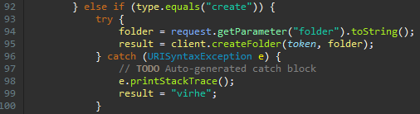
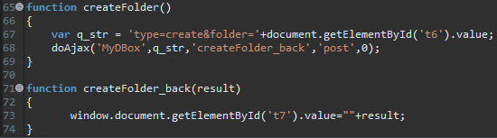
Extra actions: /create_folder

